Slide 1
Piano-Playing Robot
Task List

Slide 2
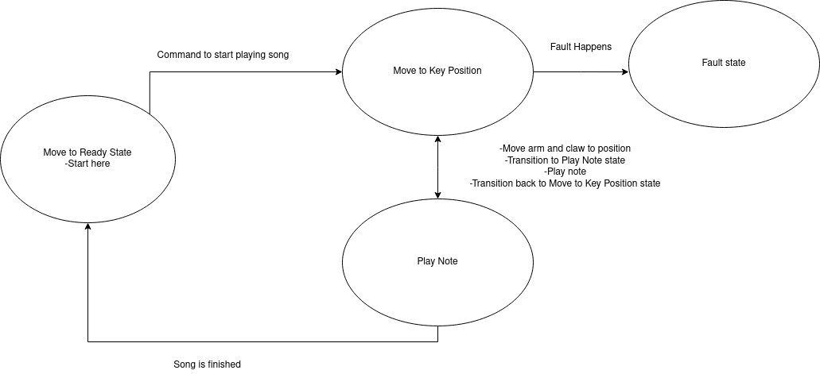

Slide 3
Tasks Overview
Read input
Move to starting position
Read the next note and move to that position
If two notes are read, open the claw to reach
Play the note(s)
Repeat 3-5 until all notes are played

Slide 4
1. Read input
Use a hard-coded array, or read from a file
Start by using X positions but eventually have it interpret note letters
Return an error on bad input (out-of-bounds X positions, invalid note letters, two notes at the same time that are too far apart, etc.)

Slide 5
2. Move to starting position
Set all joints to zero
Optional: If possible, use a camera to find the piano’s position
Center the claw over the piano
Lower claw until it’s a few cm. above the keys

Slide 6
3. Read the next note and move to that position
Get the next note from the input
If the input is note letters, convert to X position
For two notes, find the average of the positions
Move to new position

Slide 7
4. If two notes are read, open the claw to reach
Find the difference of the two notes’ positions to get the distance between them
Use the distance to determine how much to open the claw
If only one note is read, close the claw instead
Tasks 3 and 4 can be performed at the same time

Slide 8
5. Play the note(s)
Move down until the key is pressed
Wait for the duration of the note
Move up

Slide 9
6. Repeat 3-5 until all notes are played
Get the next note from the input and continue playing
Repeat until the end of the input is reached
Optional: Go back to the beginning of the input and loop the song
Optional: Move back to starting position and wait to play another song

Slide 10

Congratulations!
Your robot can play a piano!

